Slide 1
Clinical Data – Risk of Injuries

Slide 2
Clinical Data – Sharps Injuries
Up to 85%
of sharps injuries in the UK go unreported [2], which means that the actual number of sharps injuries could be much higher.
100k
sharps injuries are reported each year in the UK [1]
How many sharps injuries occur in your country?
[1] AfPP. Sharps Injuries in the Operating Theatre - A Practical Guide to Further Reducing the Risks: Purple Sugical 2015. 7.
[2] Saia M, Hofmann F, Sharman J, et al. Needlestick injuries: incidence and cost in the United States, United Kingdom, Germany, France, Italy, and Spain. Biomedicine International 2010;1(2):419.

Slide 3
Clinical Data – Scalpel Blade Injuries
17%
8%
Scalpel blade injuries are the second most common type of sharps injury in the OR, accounting for 17% of sharps injuries [1]
Scalpel blade injuries account for 8% of all sharps injuries in hospitals [2]
[1] Jagger J, Berguer R, Phillips EK, et al. Increase in Sharps Injuries in Surgical Settings Versus Nonsurgical Settings After Passage of National Needlestick Legislation. AORN Journal 2011;93(3):322-30. doi: 10.1016/j.aorn.2011.01.001
[2] MassachusettsDepartmentofPublicHealth. Overview of sharps injuries among hospital workers in Massachusetts. Massachusetts sharps injury surveillance system, 2017.

Slide 4
Clinical Data – Scalpel Blade Injuries
12.6
3.2
Incidents per 100,000 disposable syringes + loose needles used [1]
Incidents per 100,000 scalpel blades used [2]
[1] Eisenstein, H. C. and D. A. Smith (1992). "Epidemiology of reported sharps injuries in a tertiary care hospital." J Hosp Infect 20(4): 271-80.
[2] Based on the data from a tertiary hospital in Queensland, Australia (2012-2014)

Slide 5
Clinical Data – Scalpel Blade Injuries
Potential consequences
UNCOMPLICATED
Requires post-exposure management
COMPLICATED – Surgery
Requires surgery and rehabilitation
COMPLICATED – Blood-borne Infection
Requires ongoing/expensive treatment
PSYCHOLOGICAL DISTRESS & ANXIETY
A consequence of both uncomplicated and complicated sharps injuries

Slide 6
Clinical Data – BBI seroversions
Serocoversion rate of BBIs due to sharps injury:
HIV
HCV
HBV
1 in 300
1 in 30
1 in 3
[1] Doebbeling BN, Vaughn TE, McCoy KD, et al. Percutaneous injury, blood exposure, and adherence to standard precautions: are hospital-based health care providers still at risk? Clinical Infectious Diseases 2003;37(8):1006-13.

Slide 7
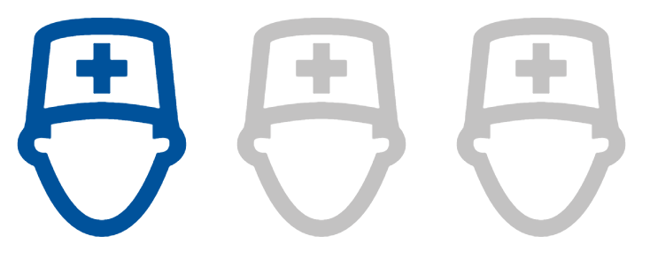
Clinical Data – Ampoule Injuries
20-33%
37%
1 in 3 nurses have hand injuries from ampoule cuts [1]
Of sharps injuries to nurses are caused by ampoules [2]
Of nurses experience more than 1 ampoule injury in 6 months [3]
[1] Smith DR, Choe M-A, Jeong JS, et al. Epidemiology of Needlestick and Sharps Injuries Among Professional Korean Nurses. Journal of Professional Nursing 2006;22(6):359-66. doi: 10.1016/j.profnurs.2006.10.003
[2] Kahriman I, Polat S, Ede G, Kaptan D. Injury experiences and precautions taken by nurses working in pediatric wards towards penetrative/incisive tools. International Journal of Caring Sciences 2016;9(2):569-578.
[3] Lien CW & Liu PH. Systematic Innovation by User-centered Design: Case Study in
Ampoule Opener Design. International Journal of Systematic Innovation 2018;5(2):45-52.

Slide 8
Clinical Data – Ampoule Injuries
54%
6%
Of sharps injuries to anaesthetists are caused by ampoules [1]
Of anaesthetists have a hand injury caused by ampoules [2]
[1] Pulnitiporn A, Chau-in W, Klanarong S, et al. The Thai Anesthesia Incidents Study (THAI Study) of anesthesia personnel hazard. Journal of the Medical Association of Thailand = Chotmaihet thangphaet 2005;88 Suppl 7:S141-4. [published Online First: 2006/07/25]
[2] Parker MRJ. The use of protective gloves, the incidence of ampoule injury and the prevalence of hand laceration amongst anaesthetic personnel. Anaesthesia 1995;50(8):726-29.

Slide 9
Clinical Data – Ampoule Injuries
Potential consequences
UNCOMPLICATED
Requires first aid and a break for the affected staff
COMPLICATED – Surgery
Requires surgery (ranging from stitches to nerve repair) and time off work
COMPLICATED – Blood-borne Infection
Requires ongoing/expensive treatment
PSYCHOLOGICAL DISTRESS & ANXIETY
A consequence of both uncomplicated and complicated sharps injuries

Slide 10
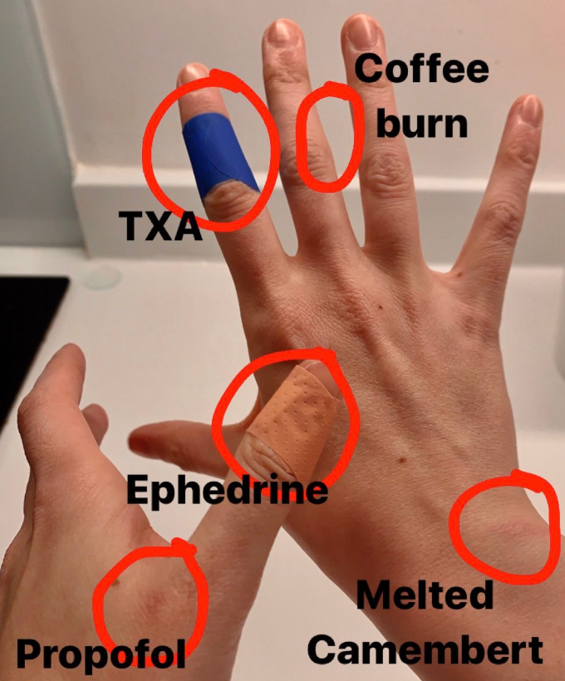
Clinical Data – Ampoule Injuries
Common medications causing ampoule injuries
Edphedrine
Fentanyl
Metoprolol
Propotol
Phenergan
Methergin
Testosterone
Bone cement
Twitter user @AGraham1208 post regarding recent causes of hand injuries

Slide 11
Clinical Data – Injury Costs

Slide 12
Cost Statistics – Scalpel Blade Injury
Uncomplicated Injury
Post-exposure management for an uncomplicated sharps injury has been estimated to cost AUD 750 – 7,500 [1]
Complicated Injury- Surgery
Surgery and rehabilitation for a complicated sharps injury has been estimated to cost AUD 1900 – 24,000 [2]
Complicated Injury-
Blood-borne Infection
In the UK, the average ongoing treatment cost for each HIV case was estimated to be £22,775 – £48,000 (AUD 44,650 – 94,000)
[1] O'Malley E, Scott R, Douglas, et al. Costs of Management of Occupational Exposures to Blood and Body Fluids. Infection Control and Hospital Epidemiology 2007;28(7):774-82 [2] Jagger J, Hunt EH, Pearson RD. Estimated cost of needlestick injuries for six major needled devices. Infect Control Hosp Epidemiol 1990;11(11):584-8.
[3] Mandalia S, Mandalia R, Lo G, et al. Rising Population Cost for Treating People Living with HIV in the UK, 1997-2013. PLOS ONE 2011;5(12):e15677.

Slide 13
Cost Statistics – Scalpel Blade Injury
To the staff member:
DISTRESS TO INDIVIDUAL & FAMILY
LOSS OF INCOME
COST OF TREATMENT
Varying degrees of distress to depression. Post-traumatic stress disorder.
Loss of individual income and productivity
Out of pocket cost of treating the injury or infection

Slide 14
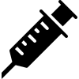
Cost Statistics – Scalpel Blade Injury
To the patient:
DELAYED OR CANCELLED PROCEDURES
ADDITIONAL BLOOD TESTS
IATROGENIC INFECTION
This has an adverse effect on the patient’s care
Blood tests to check for blood-borne infections
Could lead to further complications for the patient

Slide 15
Cost Statistics – Scalpel Blade Injury
To the healthcare facility:
SOCIAL COSTS A sharps injury can lead to: Delayed service delivery, high staff turnover, poor functioning teams, and unplanned managerial time spent investigating incidents
LEGAL ACTION
WORKER’S COMPENSATION
NON-COMPLIANCE
ADMINISTRATIVE EXPENSES

Slide 16
Cost Statistics – Ampoule Injury
Uncomplicated Injury
Complicated Injury- Surgery
Complicated Injury-
Blood-borne Infection
The costs of an uncomplicated injury includes the first aid materials and time spent away from duties (5-30 min)
Cases of ampoule injuries where stitches were required costed US $653.45 [1]. Surgery and rehabilitation for a serious sharps injury has been estimated to cost AUD 1,900 – 24,000 [2]
In the UK, the average ongoing treatment cost for each HIV case was estimated to be £22,775 – £48,000 (AUD 44,650 – 94,000) [3]
[1] https://allnurses.com/ouch-ampule-issues-anyone-else-t143333/
[2] Jagger J, Hunt EH, Pearson RD. Estimated cost of needlestick injuries for six major needled devices. Infect Control Hosp Epidemiol 1990;11(11):584-8.
[3] Mandalia S, Mandalia R, Lo G, et al. Rising Population Cost for Treating People Living with HIV in the UK, 1997-2013. PLOS ONE 2011;5(12):e15677. doi: 10.1371/journal.pone.0015677

Slide 17
Cost Statistics – Ampoule Injury
To the staff member:
LOSS OF INCOME
DISTRESS
INFECTION RISK
Loss of individual income and productivity due to days off work
Varying degrees of distress, including depression and anxiety.
Ampoule injuries can increase infection susceptibility, especially to workers in high-hazard areas (eg. OR)

Slide 18
Cost Statistics – Ampoule Injury
To the healthcare facility:
SOCIAL COSTS Delayed service delivery, high staff turnover, poor functioning teams, and unplanned managerial time spent investigating incidents
TREATMENT OF INJURY
Typically the healthcare facility must cover treatment costs for workplace injuries
WASTED MEDICATION
ADMINISTRATIVE EXPENSES
WORKER’S COMPENSATION
LEGAL ACTION

Slide 19
Cost Statistics– Flow on Benefits
Multiple studies have shown that implementing staff safety measures have the following flow on effects:
+ Increased quality of patient care and service
+ Efficient patient flow
+ Decreased absenteeism and overtime
+ Improved communication and teamwork
+ Higher work satisfaction and productivity
+ A healthier, stable workforce
+ Reduced lost time (caused by injuries)
Sikorski, J. (2009). Connecting worker safety to patient safety: a new imperative for health-care leaders. Ivey Business Journal, 73(1), 8.
Laschinger, Heather K. Spence, and Michael P. Leiter. "The impact of nursing work environments on patient safety outcomes: The mediating role of burnout engagement." JONA: The Journal of Nursing Administration 36.5 (2006): 259-267.

Slide 20
Going Forward: The Total Solution
SAFETY TOOLS
Qlicksmart’s blade removers
EVALUATE
Trial support
Value Analysis Calculator
EDUCATE
Product Support
Training App
CE/CPD Sessions
RESEARCH
Publications
Safety Innovations
Safety Score Audit

